Slide 1

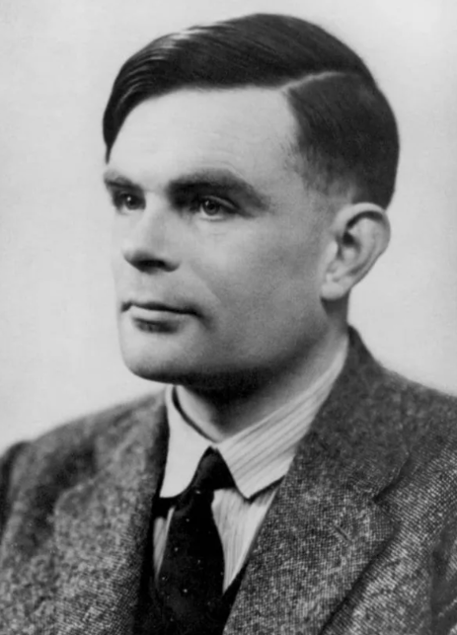
Alan Turing: The Architect of Modern Computing

Slide 2

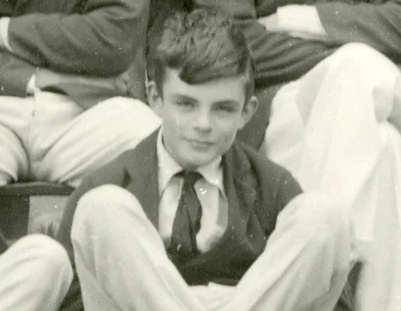
Early Brilliance
Born in London, 1912, showing extraordinary aptitude for mathematics and science from a young age.
His independent thinking and unique approach to problem-solving were evident early on.
A fascination with codes, ciphers, and the nature of computation began during his school years.

Slide 3
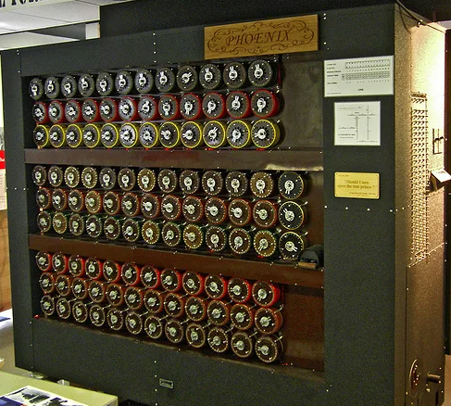
Cracking Enigma: A Wartime Hero
At Bletchley Park during WWII, Turing played a crucial role in breaking the German Enigma code.
He designed the Bombe, a machine that significantly sped up the decryption process.
His work is estimated to have shortened the war, saving countless lives.

Slide 4
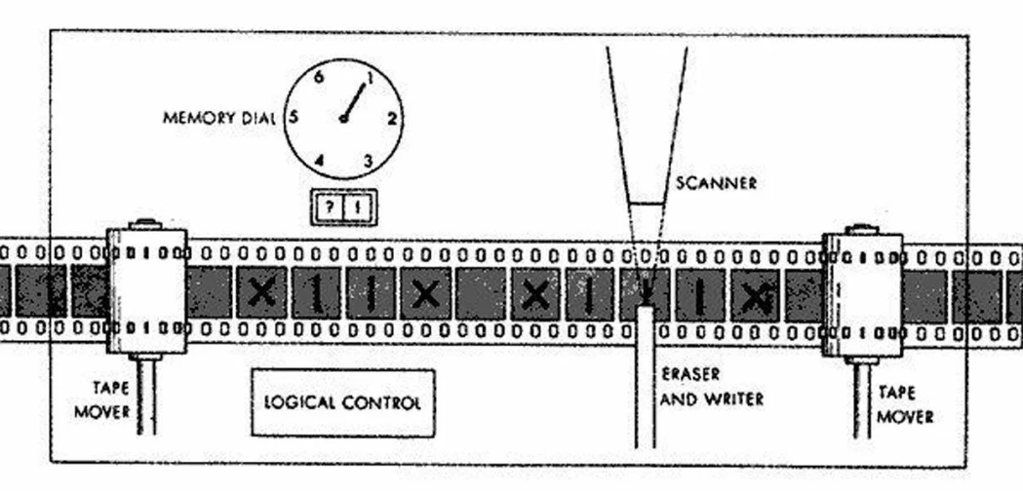
The Turing Machine: A Revolutionary Concept
In 1936, Turing introduced the Turing Machine, a theoretical model of computation.
A simple, abstract machine that could, in principle, perform any calculation.
This concept laid the foundation for the development of modern computers.

Slide 5
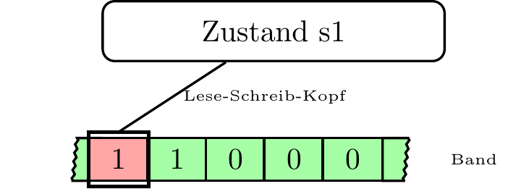
How the Turing Machine Works (Visual)
A visual representation of the Turing Machine executing a simple algorithm.

Slide 6
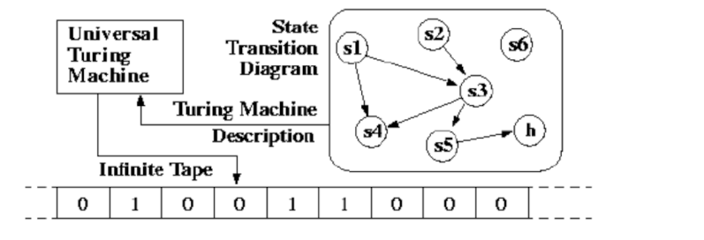
The Universal Turing Machine: Programmability
Turing conceived of a Universal Turing Machine: a machine that could simulate any other Turing Machine.
This was the key idea behind programmable computers - a single machine capable of performing many different tasks.
This is the core principle behind how our modern computers work: software programs controlling hardware.

Slide 7

The Turing Test: Defining Intelligence
Turing proposed the “Turing Test” as a way to evaluate machine intelligence.
A machine passes the test if it can convincingly imitate a human in a text-based conversation.
The Turing Test continues to be a relevant and debated topic in the field of Artificial Intelligence.

Slide 8
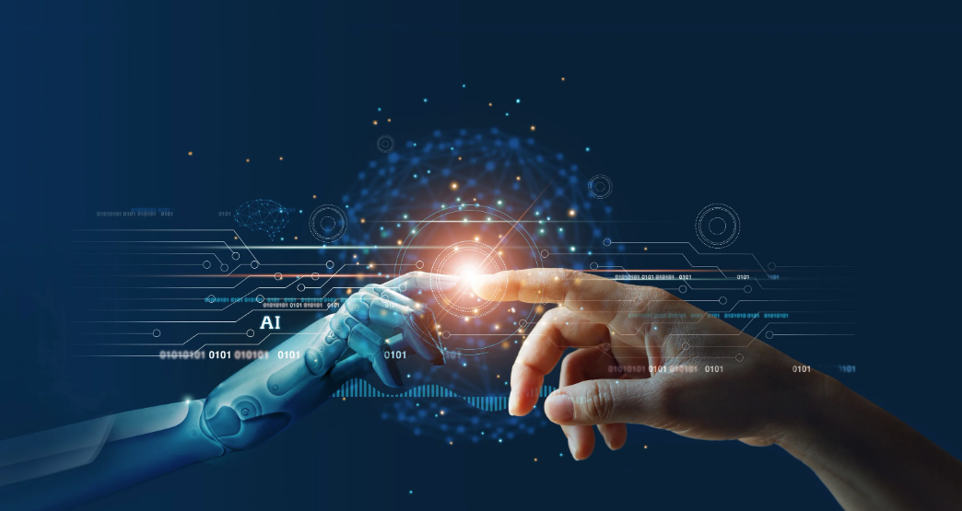
The Dawn of Artificial Intelligence
Turing was one of the earliest proponents of Artificial Intelligence.
He explored the possibilities of creating machines that could learn, reason, and solve problems.
His ideas paved the way for decades of AI research.

Slide 9

A Legacy of Innovation
Turing’s work has had a profound impact on computer science, mathematics, and artificial intelligence.
The “Turing Award” is the highest honor in computer science.
His influence continues to shape the technology we use every day.

Slide 10

A Lasting Impression
Alan Turing was a visionary who laid the foundation for the digital age. His brilliance and his contributions continue to inspire innovation.

